Slide 1
Bootstrapped Pre-training with Dynamic Identifier Prediction for Generative Retrieval
Yubao Tang^{1,2}, Ruqing Zhang^{1,2}, Jiafeng Guo^{1,2}, Maarten de Rijke³, Yixing Fan^{1,2}, Xueqi Cheng^{1,2}
¹CAS Key Lab of Network Data Science and Technology, ICT, CAS
²University of Chinese Academy of Sciences
³University of Amsterdam
{tangyubao21b,zhangruqing,guojiafeng,fanyixing,cxq}@ict.ac.cn
m.derijke@uva.nl
https://arxiv.org/pdf/2407.11504
Notes:
hi everyone,
I am yubao Tang, and I am a PC student at Chinese Academy of Sciences.
So pleased to present our work,” Bootstrapped Pre-training with Dynamic Identifier Prediction for Generative Retrieval"
This work was a collaborative effort with Ruqing, Jiafeng from CAS, Maarten from University of Amsterdam, Yixing and Xueqi from CAS
Here is a link of our paper

Slide 2
Content
Introduction
Research challenges
Approach
Experimental settings
Experimental results
Conclusion
Limitations
References
Notes:
I will introduce our work from the following aspects.

Slide 3
Introduction
Document retrieval aims to retrieve candidate documents from a huge document collection for a given query[1,2]
Dense retrieval is the dominant implementation, which encodes the query and documents into dense embedding vectors to capture rich semantics [3,4]
Generative retrieval employs a sequence-to-sequence (Seq2Seq) architecture to generate relevant document identifiers (docids) for queries[5,6]
Indexing: memorizing the entire corpus by associating each document with its docid
Retrieval: using the indexed corpus information to produce a ranked list of potentially relevant docids for a given query
Notes:
We focus on the Document retrieval task.
it is an important task with widespread applications, such as question answering and fact verification
This task aims to retrieve candidate documents from a huge document collection for a given query
Currently, the dominant implementation is dense retrieval
it encodes the query and documents into dense embedding vectors to capture rich semantics.
An emerging alternative to dense retrieval in document retrieval is generative retrieval
It employs a sequence-to-sequence architecture to generate relevant document identifiers for queries.
In this manner, the knowledge of all documents in the corpus is encoded into the model parameters,
This is similar to the human cognitive associative mechanism
To achieve this goal, GR involves two basic operations :
One operation is indexing,
it memorizes the entire corpus by associating each document with its identifier
The other operation is retrieval,
It uses the indexed corpus information to produce a ranked list of potentially relevant docids for a given query.

Slide 4
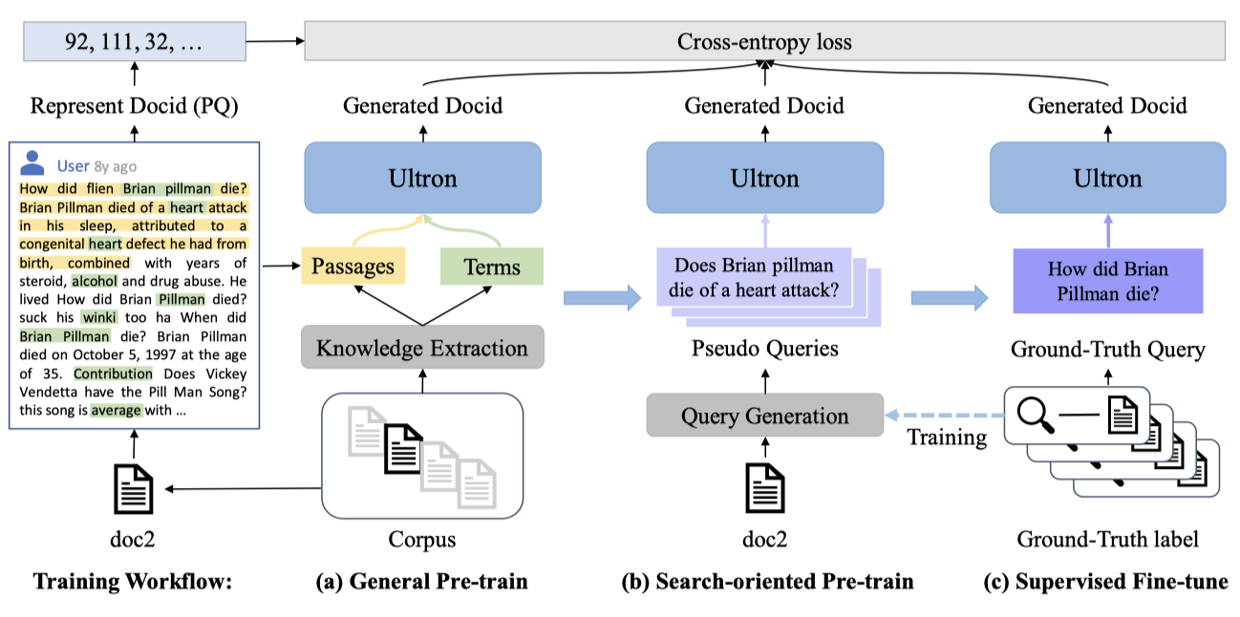
Introduction
Using general language models, e.g., BART[7] and T5[8], as the base Seq2Seq model has become a popular choice in GR[9,10]
Some work has designed pre-training objectives for GR.
Zhou et al. (2022)[11]: document pieces or pseudo-queries are used as input, and docids (e.g., product quantization code) are predicted as output with maximum likelihood estimation (MLE)
[11]
Notes:
Using general language models, such as BART and T5， as the base Seq2Seq model has become a popular choice in GR
On top of this, some work has designed pre-training objectives for GR
For example, zhou and others proposed indexing- and retrieval-based pre-training tasks;
document pieces or pseudo-queries are used as input, and docids (e.g., product quantization code) are predicted as output with maximum likelihood estimation (MLE).

Slide 5
Introduction
Using general language models, e.g., BART[7] and T5[8], as the base Seq2Seq model has become a popular choice in GR[9,10]
Some work has designed pre-training objectives for GR.
Zhou et al. (2022)[11]: document pieces or pseudo-queries are used as input, and docids (e.g., product quantization code) are predicted as output with maximum likelihood estimation (MLE)
Chen et al. (2022)[12]: construct and learn pairs of pseudo-queries and docids (i.e., Wikipedia titles) from the corpus
Applying specialized pre-trained models to GR yields superior results compared to using general language models
[12]
Notes:
Similarly, chen and others proposed retrieval-based tasks,
These tasks aim to construct and learn pairs of pseudo-queries and docids (i.e., Wikipedia titles) from the corpus.
These works demonstrate that applying specialized pre-trained models to GR yields superior results compared to using general language models.

Slide 6
Research challenges
The construction process of pre-defined docids is independent from the pre-training process
This results in a semantic gap between both processes, which could potentially hinder the retrieval performance
Docids remain unchanged during pre-training
If the initial docids are not suitable, they cannot be further adjusted after the training begins
Existing pre-training methods do not explicitly consider the interrelations between document-docid or query-docid pairs
The widely-used MLE objective may result in difficulties in distinguishing among similar documents and docids
The model should enhance its discriminative and generalization ability
Notes:
While pre-training methods have shown their effectiveness, important limitations remain in the following:
The first one
The construction process of pre-defined docids is independent from the pre-training process
This results in a semantic gap between both processes, which could potentially hinder the retrieval performance.
The second one
Docids remain unchanged during pre-training.
If the initial docids are not suitable, they cannot be further adjusted after the training begins.
Consequently, it may become challenging to learn semantics and relationships between documents, impeding the achievement of satisfactory retrieval performance.
The third one
Existing pre-training methods do not explicitly consider the interrelations between document-docid or query-docid pairs.
The widely-used MLE objective may result in difficulties in distinguishing among similar documents and docids.
Therefore, we argue that the model should enhance its discriminative and generalization ability.

Slide 7
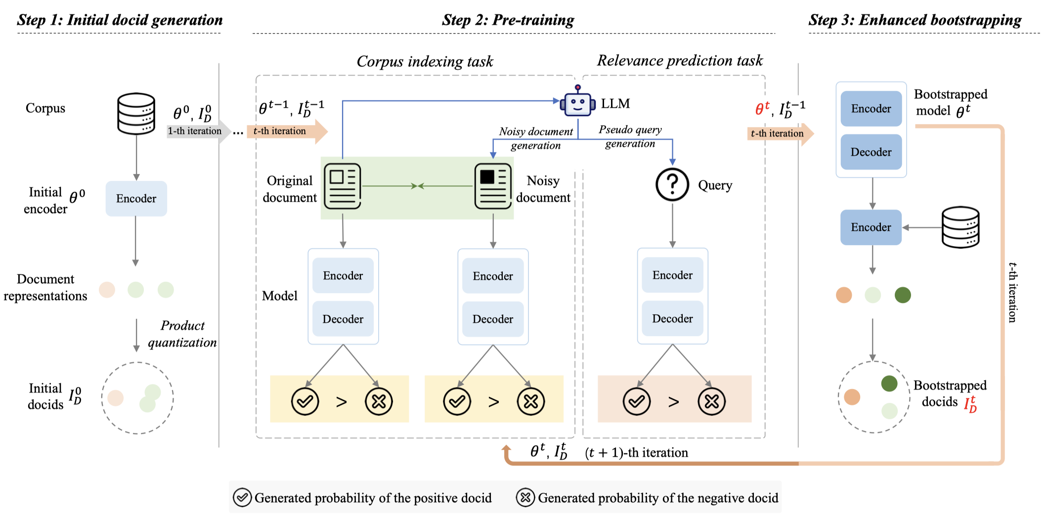
Approach
BootRet: a general bootstrapped pre-training method for GR
Key idea: dynamically adjust docids in accordance with the evolving model parameters during pre-training
The human brain updates the organization of existing knowledge to better match updated goals or contents in learning[13]
Key steps:
Initial docid generation
Pre-training
Enhanced bootstrapping
Notes:
To address these challenges, we introduce a general bootstrapped pre-training method for GR, called BootRet.
Our objective is to dynamically adjust docids in accordance with the evolving model parameters during pre-training.
The key idea is inspired by that the human brain updates the organization of existing knowledge to better match updated goals or contents in learning
BootRet includes three key steps:
Initial docid generation
Pre-training
Enhanced bootstrapping

Slide 8
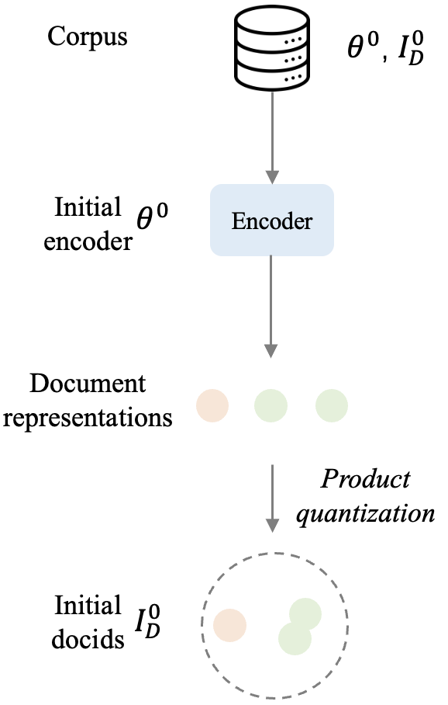
Approach
1. Initial docid generation
Encoder
Product quantization[14,15]
Notes:
For the Initial docid generation
We leverage the encoder of the initial model to encode documents and then obtain the product quantization code as the initial docids.

Slide 9
Approach
Corpus indexing task
Relevance prediction task
LLM
2. Pre-training
Corpus Indexing Task
Noisy document construction
synonym replacement
sentence removal
sentence shuffling
word masking
Semantic consistency loss
Contrastive losses
$θ^{t−1}$, $I_{D}^{t−1}$
$θ^{t}$, $I_{D}^{t−1}$
$t$-th iteration
Noisy document generation
Pseudo query generation
$t$-th iteration
Original
document
Noisy
document
Query
Encoder
Encoder
Encoder
Model
Decoder
Decoder
Decoder
>
>
>
Generated probability of the positive docid
Generated probability of the negative docid
Notes:
For the Pre-training
We design two pre-training tasks,
They are corpus indexing task and relevance predication task.
In this page, we firstly introduce The corpus indexing task
It aims to memorize corpus information and distinguish among similar documents and docids.
We construct pairs of original documents and corresponding identifiers to simulate the indexing operation.
We also design Semantic consistency loss and Contrastive losses for corpus indexing
The noisy documents should maintain semantic consistency with the originals while remaining distinguishable.
We propose using a LLM to construct noisy documents. we design the following four prompts to guide LLM generation:
A synonym replacement prompt: Replace some words in the given document with their synonyms while maintaining the overall semantic meaning
A sentence removal prompt: Remove one or more sentences from the given document, while maintaining the overall semantic meaning
A sentence shuffling prompt: Rearrange the sentences in the given document to create a new flow, while maintaining the overall semantic meaning
A word masking prompt: Mask some words with [Masked] token in the given document, while maintaining the overall semantic meaning
For the Semantic consistency loss, It aims at maintaining overall semantic consistency between original and noisy documents.
Specifically, in a mini-batch, there are a total of 4N document-docid pairs,
N pairs correspond to the original pairs, and each original document has four noisy pairs.
For the contrastive losses
Conditioned on original document-docid pairs, we encourage the model to generate a docid that corresponds to the document rather than the docids of other documents.
In the same mini-batch, we aim for the model to generate the docid corresponding to the document with a higher probability than generating others.
The loss is formulated as this equation
Similarly, for noisy pairs, the loss is defined as this equation
The pre-training objective of the corpus indexing task is a weighted sum of the three aforementioned losses

Slide 10
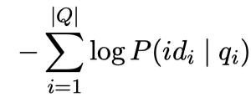
Approach
Corpus indexing task
Relevance prediction task
2. Pre-training
Relevance prediction task
Pseudo-query construction
Pre-training objective
Joint learning
$θ^{t−1}$, $I_{D}^{t−1}$
LLM
$θ^{t}$, $I_{D}^{t−1}$
$t$-th iteration
Noisy document generation
Pseudo query generation
$t$-th iteration
Original
document
Noisy
document
Query
Encoder
Encoder
Encoder
Model
=
Decoder
Decoder
Decoder
>
>
>
Generated probability of the positive docid
Generated probability of the negative docid
Notes:
The relevance prediction task aims to learn relevance information from the corpus.
We construct pairs of pseudo-queries and relevant docids to simulate the retrieval operation.
We also use a LLM to generate high-quality pseudo-queries for original documents as input and design a contrastive loss for the model to predict and contrast docids.
the key idea for the loss is that, we ensure that the model tends to generate relevant docids than irrelevant ones.
We jointly pre-train the model with two above objectives and two sequence generation objectives.
In the t-th iteration, the overall loss is defined as this equation
L_ID is the widely used standard MLE loss based on document-docid pairs
L_RE is based on query-docid pairs

Slide 11
Approach
Step 2: Pre-training
Step 3: Enhanced bootstrapping
……
Bootstrapped
model
3. Enhanced bootstrapping
Docid update: Fixing $θ^{t}$ , we use the encoder of $θ^{t}$ to encode documents as, to update docids of the previous iteration $I_{D}^{t−1}$ , to $I_{D}^{t}$
Retrain the model: To proceed to the next iteration, we retrain the model with $I_{D}^{t}$. After multiple iterations, we achieve continuous dynamic alignment and enhancement
$θ^{t−1}$, $I_{D}^{t−1}$
$θ^{t}$, $I_{D}^{t−1}$
Encoder
$$θ^{t}$$
$t$-th iteration
$t$-th iteration
Decoder
Encoder
$t$-th iteration
Bootstrapped
docids
$$I_{D}^{t}$$
$θ^{t}$, $I_{D}^{t}$
($t+1$)-th iteration
Notes:
Based on the updated \theta^{t}, we introduce how to update docids I_D^{t-1} and retrain the model.
To update Docids
Fixing \theta^{t}, we use the encoder of \theta^{t} to encode documents, to update docids of the previous iteration I_D^{t-1}, to I_D^{t}.
We refer to the version following the initial iteration's completion (i.e., I_D^{1} and \theta^{1}) as BootRet-Bs.
Furthermore,
To proceed to the next iteration, we retrain the model with I_D^{t} as described in step 2
After multiple iterations, we achieve continuous dynamic alignment and enhancement.
We refer to this version as BootRet-Mt.
Now, we covered the approach part

Slide 12
Experimental settings
Pre-training corpus
English Wikipedia[16]
MS MARCO Document Collection[17]
Sample 500K documents
Generate four noisy documents and five pseudo-queries, for each document
This results in 2.5M documents and 2.5M pseudo-queries for pre-training
Downstream retrieval datasets
MS MARCO Document Ranking dataset[17]: a subset of 300K documents (360K training queries, 6980 evaluation queries)
Natural Question (NQ)[18]: 228K documents (307K training queries, 7.8K test queries)
Baselines
Sparse retrieval baselines: BM25[19] and DocT5Query[20]
Dense retrieval baselines: RepBERT[21], DPR[22], and ANCE[23]
Advanced GR baselines: DSI[6], GENRE[10], SEAL[9], DSI-QG[24], NCI[25], Ultron-PQ[11], Corpusbrain[12], GenRet, and NOVO[27]
Notes:
Next, we introduce the experimental settings
For pre-training we use two large, publicly available corpora:
The one is English Wikipedia, it contains tens of millions of well-written documents ,
The other is MS MARCO Document Collection. It has about 3 million documents extracted from web documents using the Bing search engine.
For each corpus, we sample 500K documents and generated four noisy documents and five pseudo-queries, for each document.
This results in 2.5M documents and 2.5M pseudo-queries for pre-training.
For Downstream retrieval datasets We leverage two representative retrieval datasets.
The one is MS MARCO Document Ranking dataset.
Following the existing setupm we sample a subset of 300K documents for experimentation, denoted as MS 300K, containing 360K training queries, 6980 evaluation queries.
These documents do not overlap with the ones used in pre-training.
The other is Natural Question, it has real questions and Wikipedia documents, having about 228K documents with 307K training queries and 7.8K test queries.
Following typical GR research, we examine three types of baseline: sparse retrieval, dense retrieval, and advanced gr baselines.

Slide 13
Experimental settings
Evaluation metrics
Hits@K with K = { 1, 10 }
MRR@K with K = { 3, 20 }
Implementation details
Pre-training:
noisy documents and pseudo-queries generation： LLaMA-13b[28]
Backbone: T5-base[8]
PQ: length 24; cluster 256; vector dimension 768 [12]
The max training step is 500K, with the first iteration occurring at step 100K, followed by iterations every 40K steps thereafter
Finetuning:
Use the pre-trained model obtained from the last iteration to generate docids
Models are further fine-tuned with document-docid pairs and labeled query-docid pairs with MLE[6]
Generate 10 pseudo-queries for each document to enhance training[24]
Notes:
Following GR work, for NQ, we use hit ratio as the metric.
For MS 300K, we also use mean reciprocal rank
Due to the limited time, for the implementation details, please refer to our paper

Slide 14
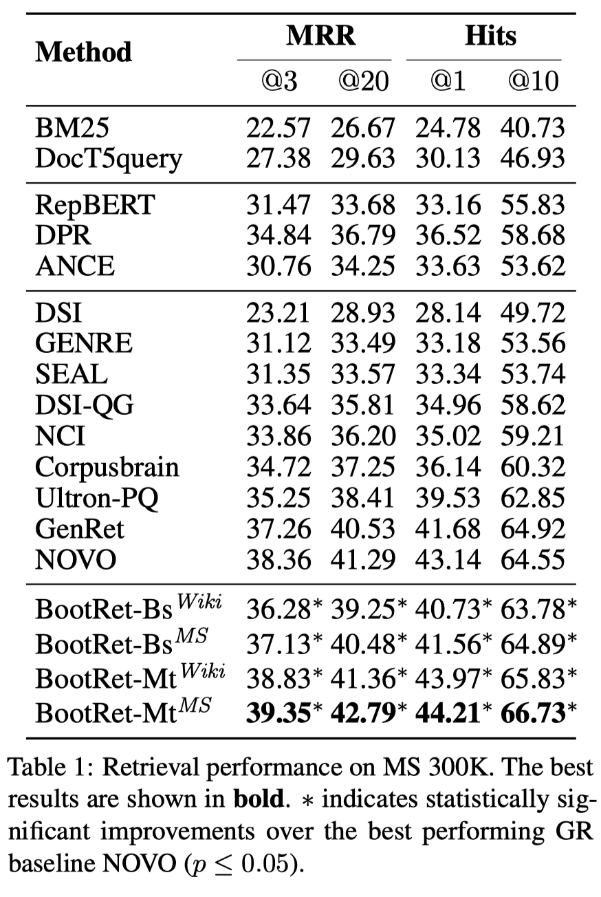
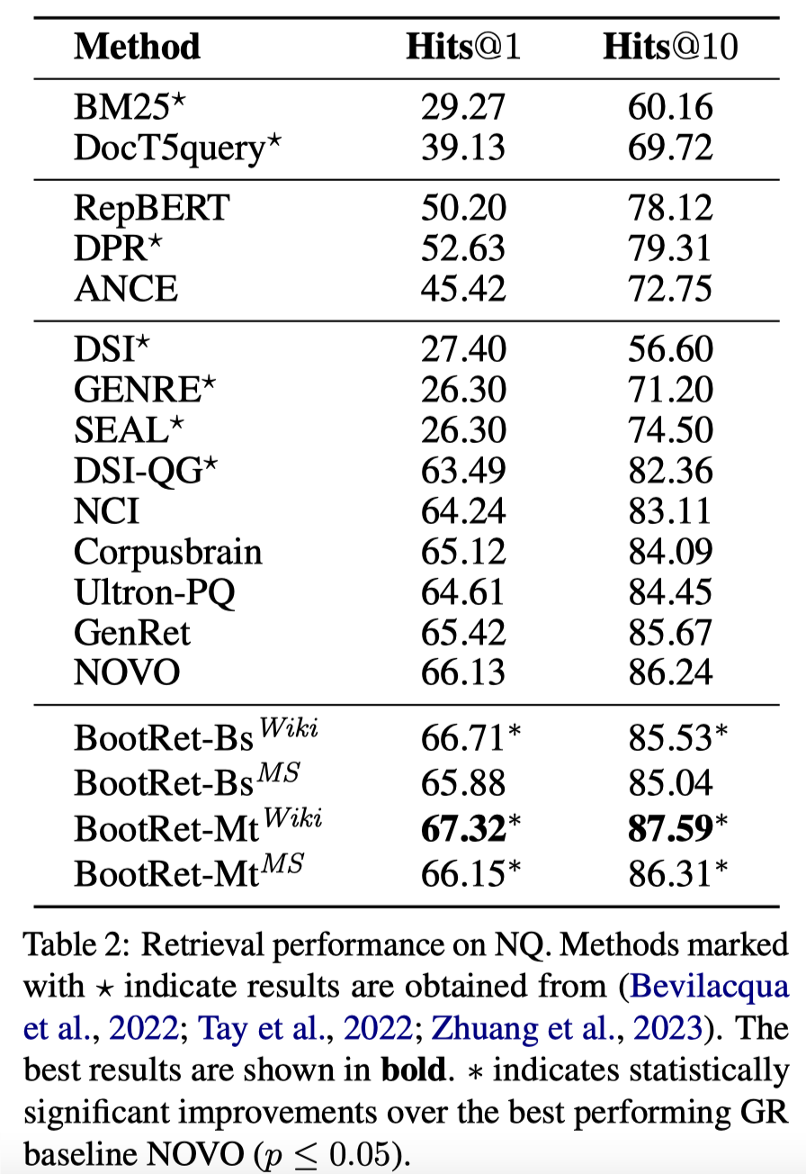
Experimental results
Main results
Notes:
Next, we introduce experimental results
The comparison between our BootRet and baselines on MS 300K and NQ are shown in these two Tables， respectively.
We observe:
the performance of BootRet-Mt is better than strong gr baselines, which demonstrates the effectiveness of our approach.
Similar conclusions are observed in NQ as shown in the table on the right.

Slide 15
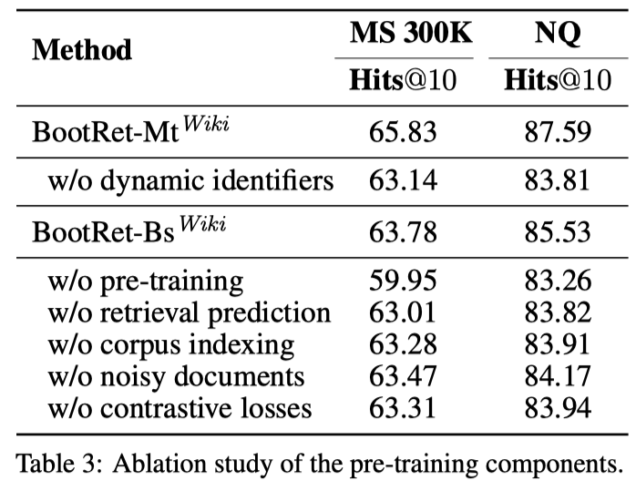
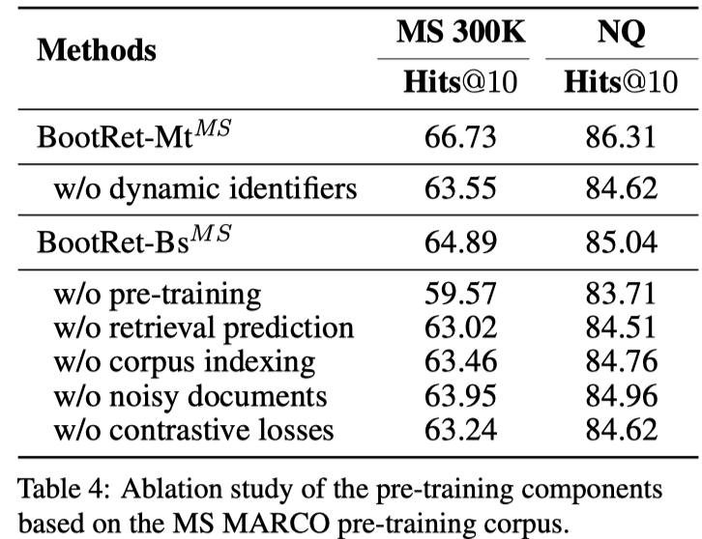
Experimental results
Ablation Study
on wikipedia corpus.
Notes:
To analyze the impact of each part of BootRet, we conduct ablation study on the Wikipedia pre-training corpus.
From the Table on the left, we observe the following: each compnenet is important for our method

Slide 16
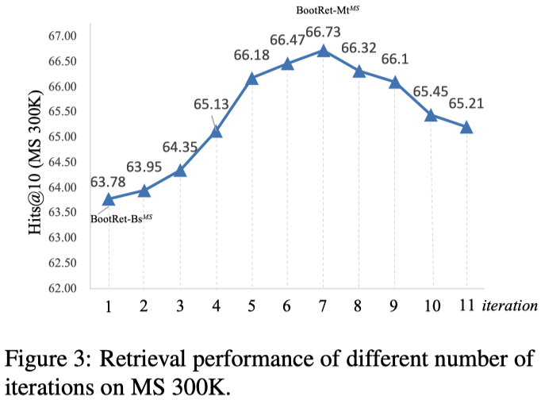
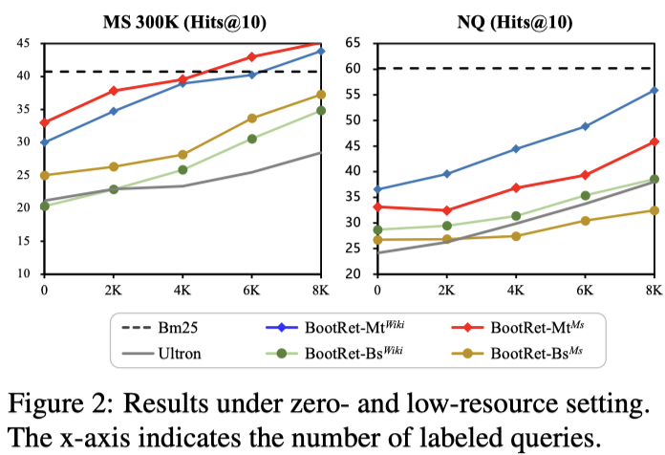
Experimental results
Zero- and Low-resource Settings
Impact of the Number of Iteration
Notes:
As shown in the figure on the left, Under zero-and low-resource settings, our method perform prominsing
The iteration of updating docids and model parameters is important in our method.
In Figure on the right, we find that performance generally improves as the number of iterations increases from 1 to 7, indicating the effectiveness of the bootstrapping pre-training method.

Slide 17
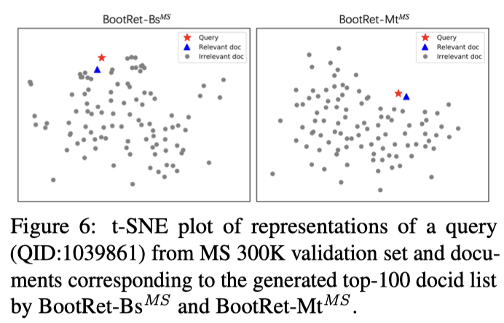
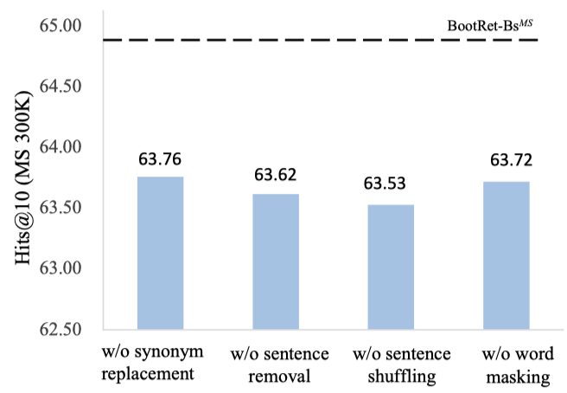
Experimental results
Impact of Noisy Documents
Visual Analysis
Notes:
To analyze the impact of different prompts for generating noisy documents, we remove noisy documents generated using a certain type of prompt during pre-training to train BootRet-Bs$^\mathit{MS}$ and evaluate its retrieval performance on the downstream MS 300K dataset.
The results are shown in the Figure on the left.
To further analyze the bootstrapped pre-training, we conduct visual analysis on BootRet-Bs and BootRet-Mt on MS 300K.
For more details, please refer to our paper

Slide 18
Conclusion
We proposed BootRet, a bootstrapped pre-training method for GR, addressing the mismatch between pre-defined fixed docids and evolving model parameters in existing pre-training approaches
It dynamically adjusts docids based on the model pre-trained with two tasks
Extensive experiments validate that BootRet achieves superior performance compared to strong GR baselines on downstream tasks, even in the zero-shot setting
Notes:
To sum up,
In this work, we proposed BootRet, a bootstrapped pre-training method for GR,
it addresses the mismatch between pre-defined fixed docids and evolving model parameters in existing pre-training approaches.
It dynamically adjusts docids based on the model pre-trained with two tasks.
Extensive experiments validate that BootRet achieves superior performance compared to strong GR baselines on downstream tasks, even in the zero-shot setting.

Slide 19
Limitations
Higher computational cost: Compared to other GR pre-training methods, our pre-training incurs slightly higher computational costs due to the need to update docids at each iteration
Incremental scenarios : For handling incremental documents, we ignore this issue in this work. For future work, inspired by (Chen et al., 2023), we could adaptively adjust cluster centers in the docid generation process based on the similarity between new and old documents
Limited scalability: Currently, a few works (Pradeep et al., 2023; Zeng et al., 2023) are exploring this issue. Differently, our work focuses on pre-training for GR which can provide suitable base model for GR. Therefore, the size of our experimental datasets follows that of most current GR works
Notes:
While BootRet has shown certain results in GR, it still has several limitations as the Higher computational cost,
Incremental scenarios and limited Scalability

Slide 20
References
[1] Unsupervised corpus aware language model pre-training for dense passage retrieval
[2] DC-BERT: Decoupling question and document for efficient contextual encoding
[3] Dcn+: Mixed objective and deep residual coattention for question answering
[4] Optimizing dense retrieval model training with hard negatives
[5] Recent advances in generative information retrieval
[6] Transformer memory as a differentiable search index
[7] BART: Denoising sequence-to-sequence pre-training for natural language generation, translation, and comprehension
[8] Exploring the limits of transfer learning with a unified text-to-text transformer
[9] Autoregressive search engines: Generating substrings as document identifiers
[10] Autoregressive entity retrieval
[11] Ultron: An ultimate retriever on corpus with a model-based indexer
[12] Corpusbrain: Pre-train a generative retrieval model for knowledgeintensive language tasks
[13] Dynamic updating of hippocampal object representations reflects new conceptual knowledge
[14] Optimized product quantization
[15] Jointly optimizing query encoder and product quantization to improve retrieval performance
[16] Wikipedia. 2022. Data dumps. https://dumps.wikimedia.org/enwiki/latest/ enwiki-latest-pages-articles.xml.bz2
[17] MS MARCO: A human generated machine reading comprehension dataset
[18] Natural questions: A benchmark for question answering research
Notes:
Here are our main citations

Slide 21
References
[19] Okapi at TREC-3
[20] From doc2query to doctttttquery
[21] RepBERT: Contextualized text embeddings for first-stage retrieval
[22] Dense passage retrieval for open-domain question answering
[23] Approximate nearest neighbor negative contrastive learning for dense text retrieval
[24] Bridging the gap between indexing and retrieval for differentiable search index with query generation
[25] A neural corpus indexer for document retrieval
[26] Learning to tokenize for generative retrieval
[27] NOVO: Learnable and interpretable document identifiers for model-based IR
[28] LLaMA: Open and efficient foundation language models

Slide 22
Thank you for joining us!
tangyubao21b@ict.ac.cn
Notes:
Thank you all for listening. If you have any questions, please feel free to reach out to me via email.

